Slide 1
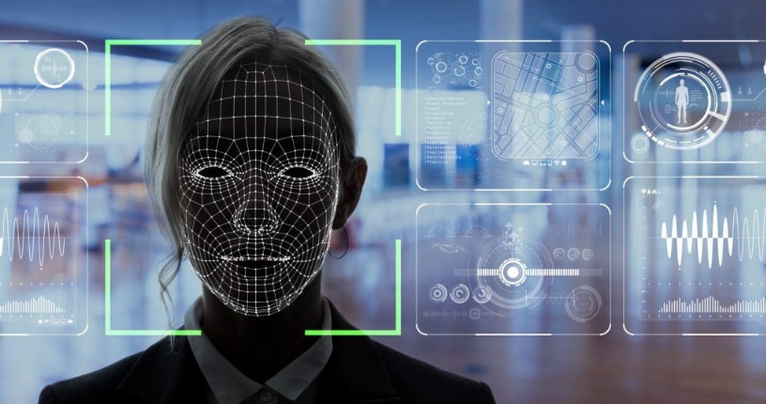
Facial Image Recognition using CRI-AI Thermal Cameras
Image Source: https://ngscinc.com/access-control-trends-for-2021-facial-recognition/

Slide 2
Content
Project Summary
Team Profile
Project Progress update
Individual Status Report
High-Level Timeline Chart (GANTT)
Plans for the next weekly status report

Slide 3
Project Summary
Purpose of this project is to develop a model a facial recognition system using CRI- AI Thermal cameras. CRI stands for Color Rendering Index and is nothing but a specification of cameras which states how accurately artificial light shows colors of the people under them.
Facial Recognition is the process of identifying a person through his or her facial features. We will be using thermal cameras to detect human faces. When we think about thermal images in the context of people, what usually comes to mind is night vision. The ability to see a person, or group of people, by the inevitable heat their bodies emit.
An important aspect of our project requires us to understand that thermal images capture heat in the form of frequency of pixels, varying from 0 to 1. Studies have found that each face emits a unique heat signature due to the blood vessels below the skin, as mentioned by Barclay (2013). Therefore, thermal facial images capture unique individual facial heat signatures which mark as unique biomarkers, providing us with rich information to classify a person correctly using a model.

Slide 4
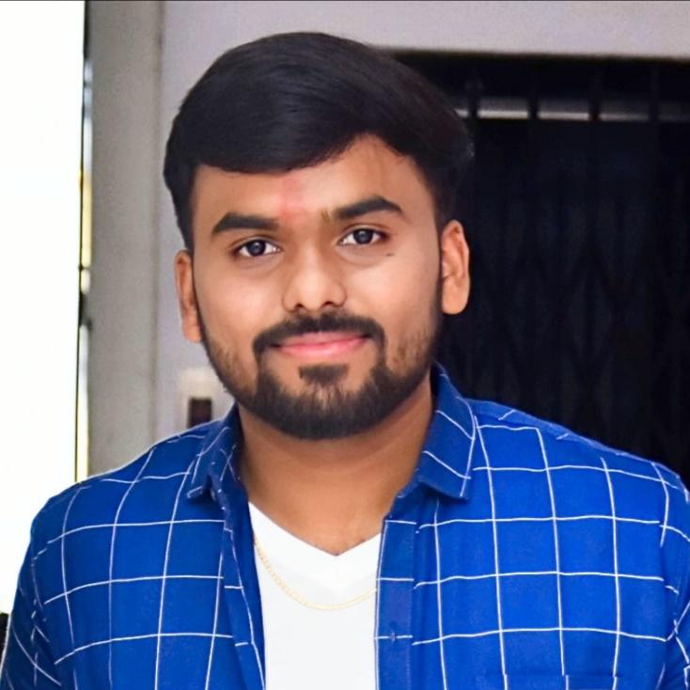
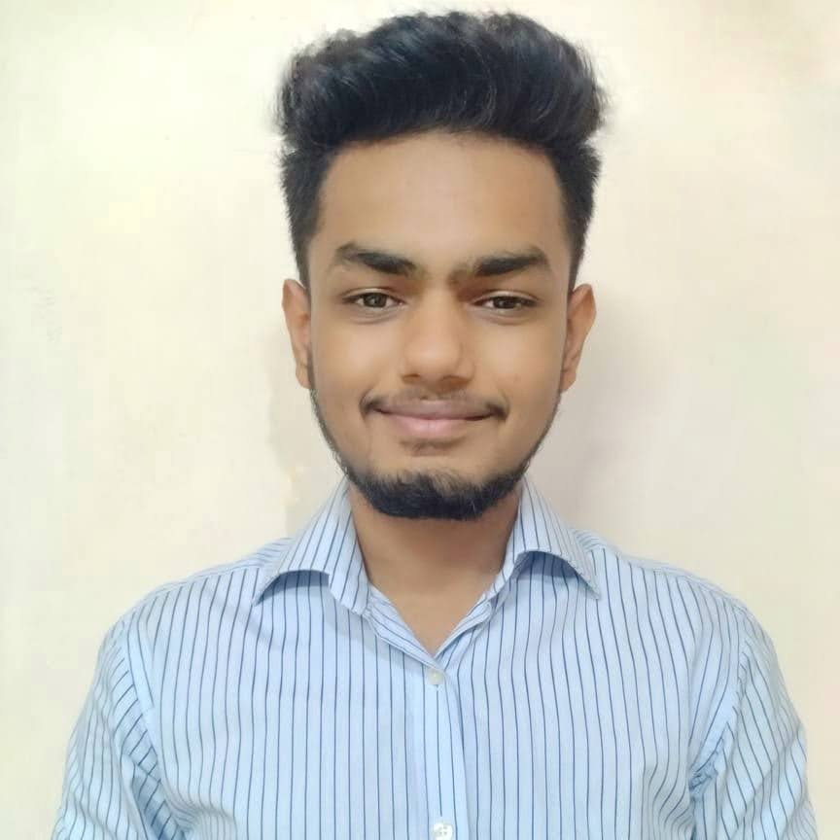

Team Profile
Kishan Patel
(B.Sc. Physics, PGDCA, Big Data Solution Architecture)
A Big Data Analyst having non-cs bachelor degree, yet significantly interested, and competent in AI industry.
Tilak Pandya
(BCA, MCA)
A developer who explores concepts and potential in the tech industry.
Namrakumar Patel
(B.E. Computer Science)
A developer with real-world problem solving experience and a desire for innovation.

Slide 5
Project Progress Update
Convert Image in gray scale
Store multiple images in dataset
Code Optimization
Update Git repository
Presentation.

Slide 6
Individual Status Report
Namra:
Identify ways to store images in Dataset and Develop code for that
Tilak:
Convert Image to gray scale
Kishan:
Code optimization
Presentation

Slide 7
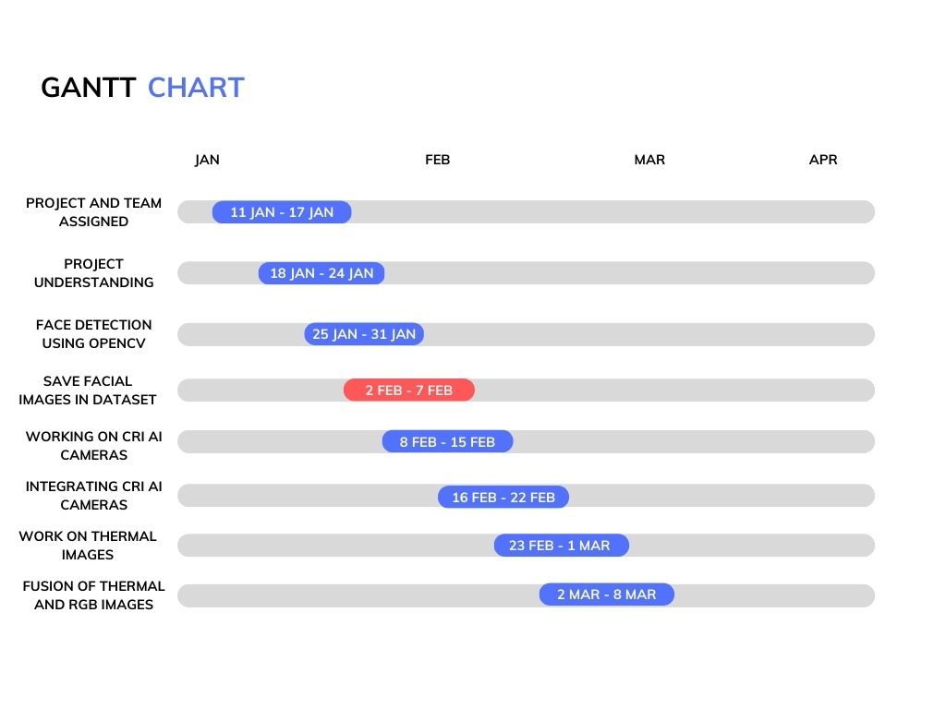
High-Level Timeline Chart (GANTT)

Slide 8
Now Onwards …
Get the CRI AI Cameras.
Convert captured images to thermal images.
Work upon Image Segmentation.
Start working on integration of CRI AI Cameras.

Slide 9
Thank you!

